Slide 1
1. Defining the Project, Ch. 4-T1
2. Estimating Project Times and Costs,
Ch. 5-T1
M K Hamirwasia
WILPD

Slide 2
AE/DE/MM/ES/POM ZG523-Merged
Project Management
Lecture No. 14

Slide 3
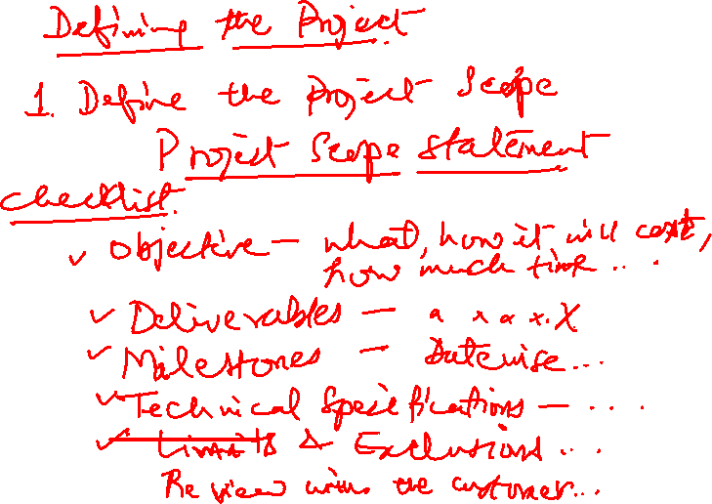

Slide 4
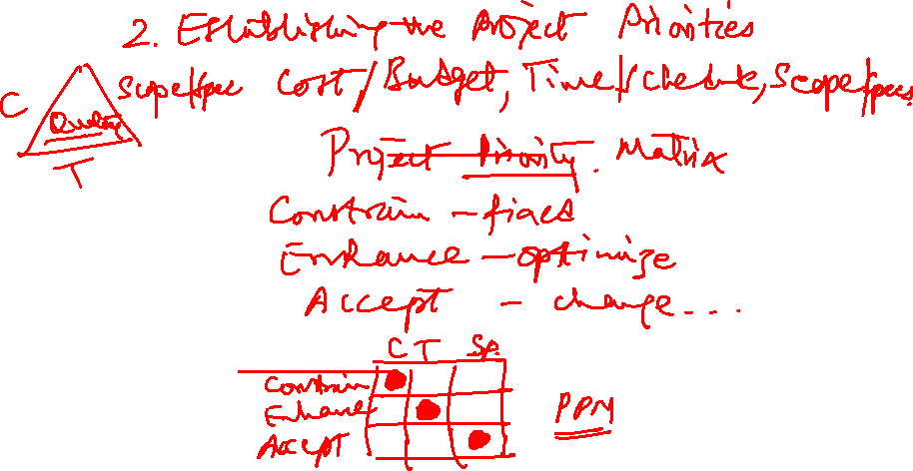

Slide 5

STEP 3: CREATING THE WORK BREAKDOWN STRUCTURE
A Work Breakdown Structure (WBS) is used for breaking down a project into easily manageable components, or bites.
Company owners and project managers use the Work Breakdown Structure (WBS) to make complex projects more manageable.
The WBS is designed to help break down a project into manageable chunks that can be effectively estimated and supervised.

Slide 6
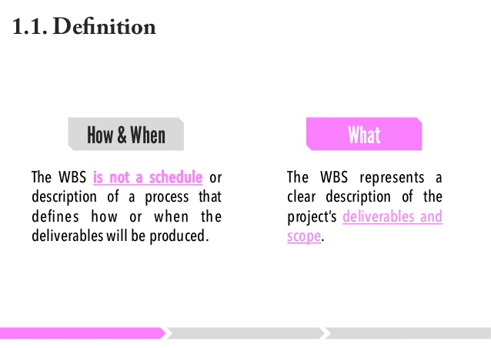
WBS

Slide 7
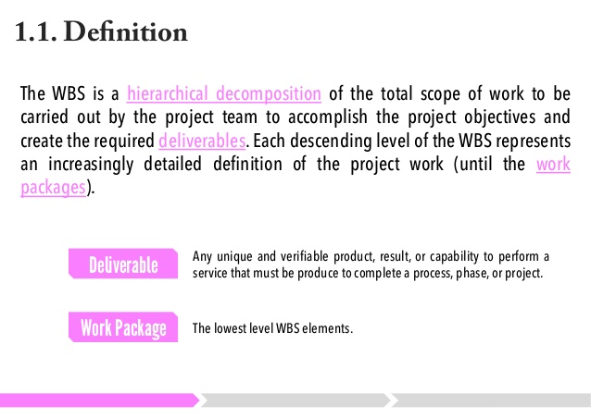

WBS

Slide 8
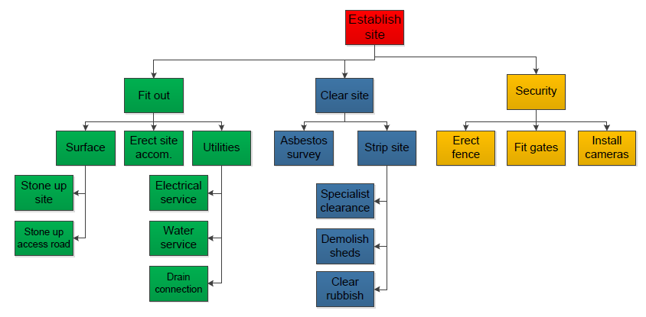
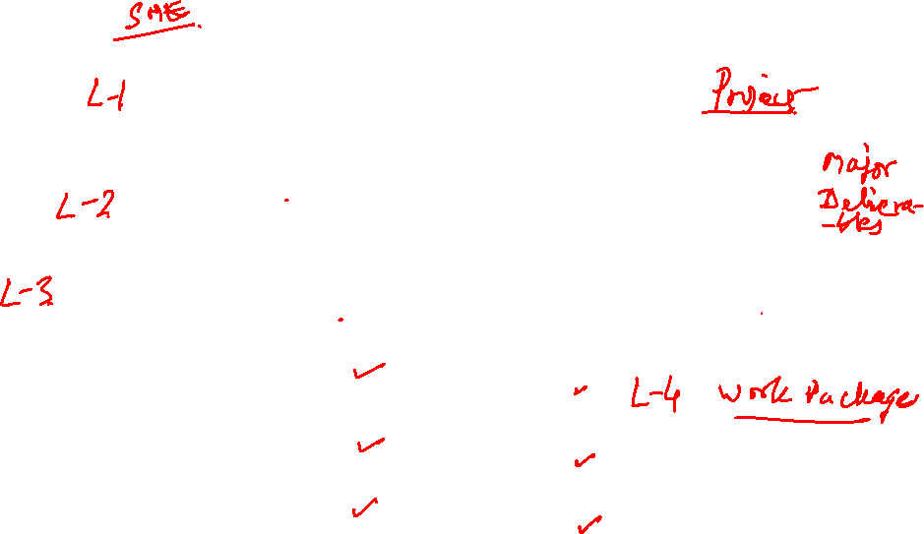
Simple WBS Example

Slide 9
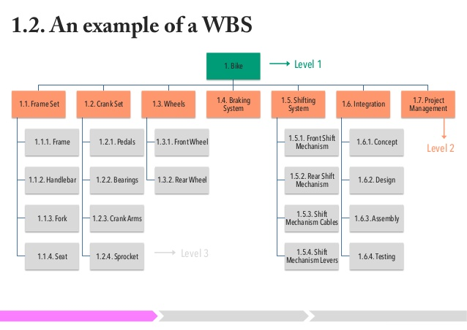
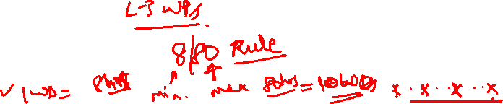
Bicycle WBS

Slide 10
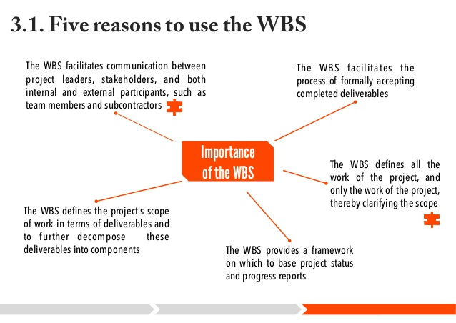
WBS

Slide 11
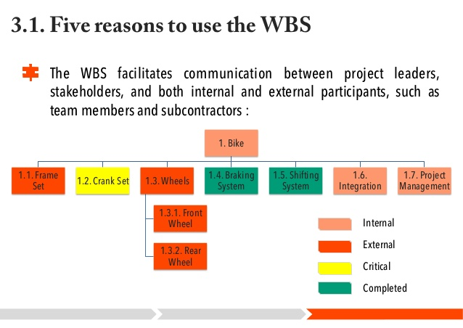
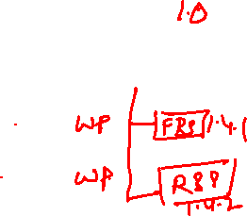
WBS

Slide 12
Constructing a Work Breakdown Structure
To start out, the project manager and subject matter experts determine the main deliverables for the project. Once this is completed, they start decomposing the deliverables they have identified, breaking them down to successively smaller chunks of work.
"How small?" you may ask. That varies with project type and management style, but some sort of predetermined “rule" should govern the size and scope of the smallest chunks of work. There could be a two weeks rule, where nothing is broken down any smaller than it would take two weeks to complete.
You can also use the 8/80 rule, where no chunk would take less than 8 hours or longer than 80 hours to complete.

Slide 13
Format
Regarding the format for WBS design, some people create tables or lists for their work breakdown structures, but most use graphics to display the project components as a hierarchical tree structure or diagram.

Slide 14
What is a Work Breakdown Structure Diagram?
A WBS diagram expresses the project scope in simple graphic terms. The diagram starts with a single box or other graphic at the top to represent the entire project. The project is then divided into main, or disparate, components, with related activities (or elements) listed under them. Generally, the upper components are the deliverables and the lower level elements are the activities that create the deliverables.

Slide 15

WBS Checklist
This is a checklist to use when reviewing the quality of a Work Breakdown Structure.
Does it define 100% of the work that will be produced by the project?
Does each element represent a deliverable?
Does it use a coding structure so that each element has a unique ID that shows its place in the hierarchy e.g. 1.1, 1.2, 1.1.1, 1.1.2?
Will project stakeholders be able to understand the project scope from the WBS?
Does it capture all external and internal deliverables including project management deliverables?

Slide 16

WBS Checklist
Does each level represent 100% of the work required to deliver the parent level?
Is the decomposition sufficient that the tasks required to deliver each work package can easily be identified?
Is it in the format that gives a clear graphical, textual or tabular breakdown of the project scope?
Is a hierarchical structure used?
Does it have at least two levels with at least one level of decomposition?
Was it created by those who will be performing the work?
Is it being regularly updated as project changes are approved?

Slide 17
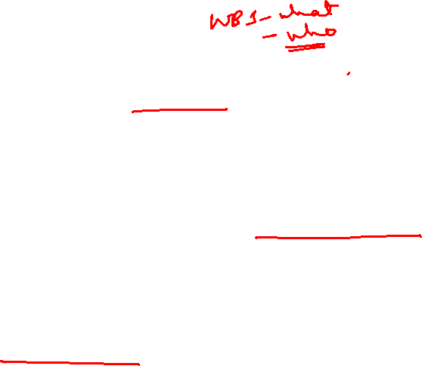
WBS Checklist
Can you identify one person who is accountable for each work package?
Can you clearly define the acceptance criteria for each work package?
Does it allow you to estimate costs accurately?
Does the WBS have logical summary elements that can be used in tracking progress and performance?
Does the WBS provide sufficient detail to create an Organizational Breakdown Structure and Resource Assignment Matrix?
Is there an alignment between the WBS and project accounting structures?

Slide 18
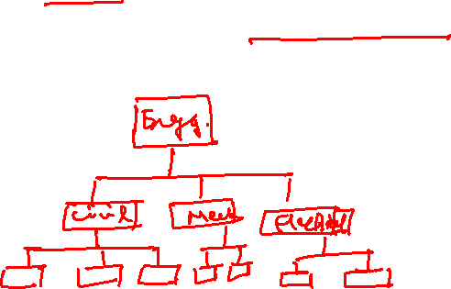
WBS Checklist
Is the WBS sufficient to support reporting at a team, project, program and portfolio level?
Does the WBS align with the size and complexity of the project?
Is it sufficiently detailed to support planning and control, but not so detailed as to become cumbersome?

Slide 19
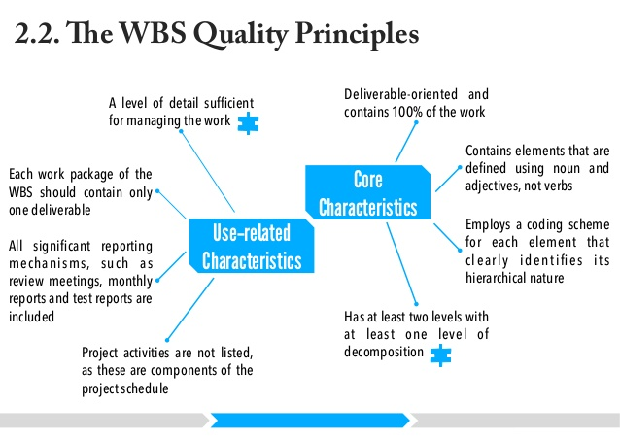
WBS

Slide 20
How WBS Helps the PM
The hierarchical structure facilitates evaluation of cost, time and performance at all levels in the organization over the life of the project.
The WBS also provides mgmt with info appropriate to each level. Eg. Top mgmt deals with major deliverables, while first-line supervisors deal with smaller sub deliverables and work packages.
Each item in the WBS needs a time and cost estimate. The WBS also serves as a framework for tracking cost and work performance.

Slide 21
How WBS Helps the PM
As the WBS is developed, organizational units and individuals are assigned responsibility for executing work packages. This integrates the work and the organization. This process is sometimes called the organization breakdown structure (OBS).
The WBS can also be used to define communication channels and assist in understanding and coordinating many parts of the project.
The structure shows the work and organizational units responsible and suggests where written communication should be directed.
Problems can be quickly addressed because the structure integrates work and responsibility.

Slide 22
WBS Development
At the top is the project end item.
This is broken into major deliverables.
Define sub deliverables necessary to accomplish the larger deliverables.
Each sub deliverable includes work packages that will be completed by an assigned organizational unit.
A sub deliverable includes outcomes of more than one work package from perhaps 2 or 3 departments.
The lowest level of the WBS is called a work package. Work packages are short-duration tasks that have a definite start and stop point, consume resources, and represent cost. Each work package is a control point.

Slide 23
WORK PACKAGE
A work package manager is responsible for seeing that the package is completed on time, within budget, and according to technical specifications.
Thus, the work package is the basic unit used for planning, scheduling and controlling the project.
Each work package in the WBS
1. Defines work (what).
2. Identifies time to complete a work package (how long).
3. Identifies a time-phased budget to complete a work package (cost).
4. Identifies resources needed to complete a work package (how much).

Slide 24
WBS Development
5. Identifies a single person responsible for units of work (who).
6. Identifies monitoring points for measuring progress (how well).
Every effort should be made to develop a WBS that is output oriented.

Slide 25
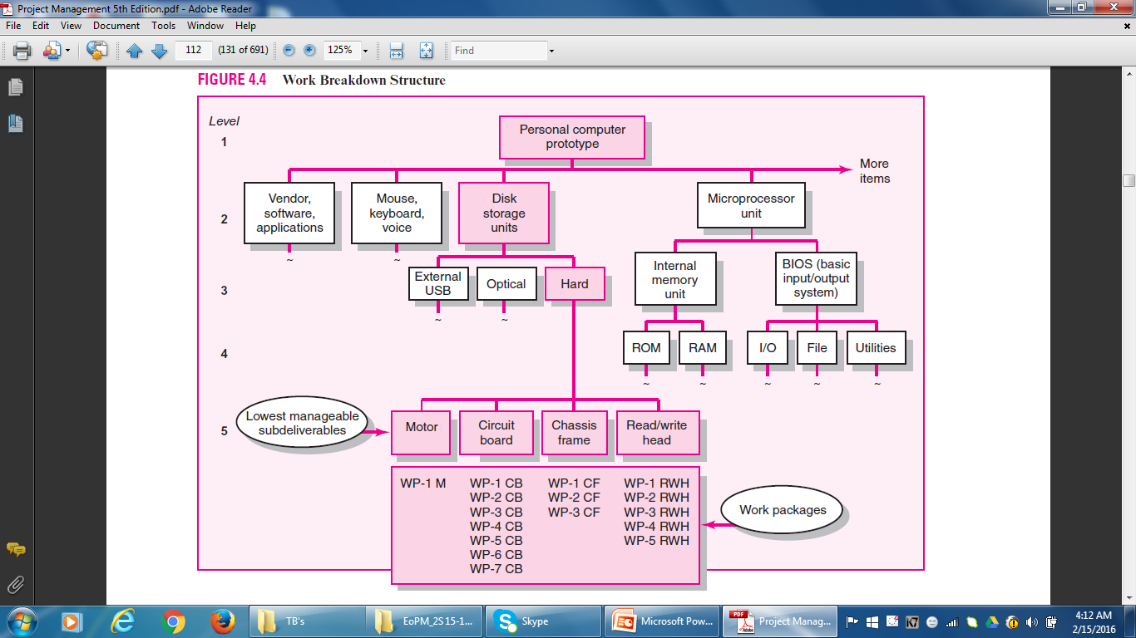
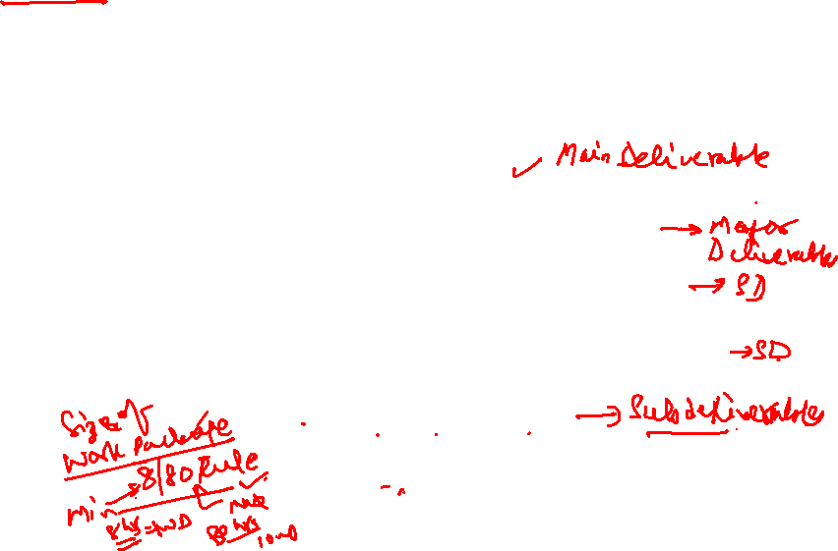
WBS

Slide 26
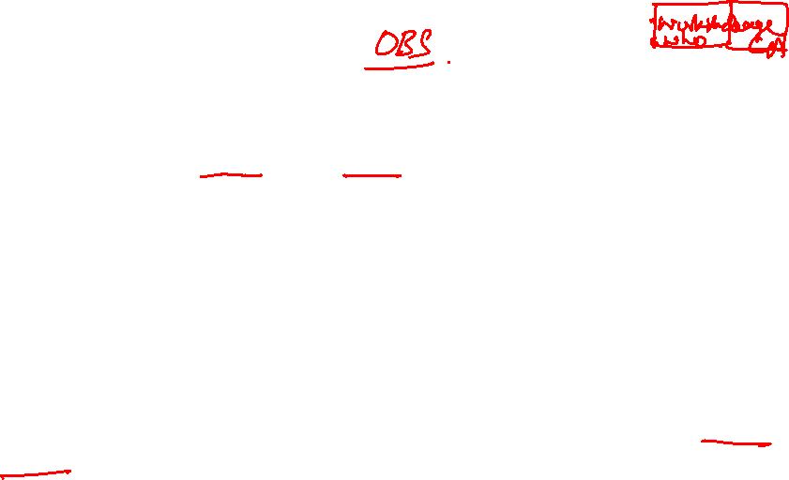
STEP 4: INTEGRATING the WBS with the ORGANIZATION
The WBS is used to link the organizational units responsible for performing the work. The outcome of this process is the OBS. The OBS depicts how the firm has organized to discharge work responsibility.
The purpose of the OBS are to provide a framework to summarize organization unit work performance, identify organization units responsible for work packages, and tie the organizational unit to cost control accounts.
The intersection of work packages and the organizational unit creates a project control point (cost account) that integrates work and responsibility.

Slide 27
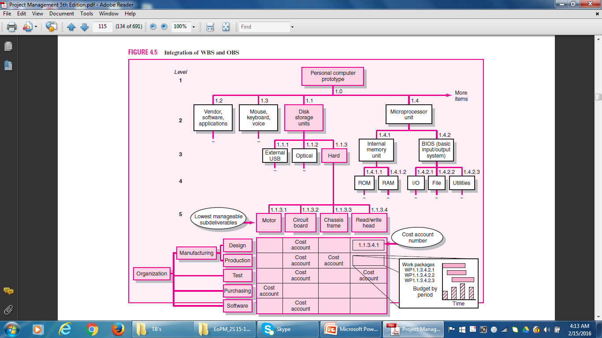

Integrating WBS and OBS

Slide 28
STEP 5: CODING the WBS for the INFORMATION SYSTEM
Codes (numeric indentation) are used to define levels and elements in the WBS, organization elements, work packages, and budget and cost information.
Each successive indentation represents a lower element or work package.
Ultimately, the numeric scheme reaches down to the work package level, and all tasks and elements in the structure have an identification code.
The cost account is the focal point because all budgets, work assignments, time, cost, and technical performance come together at this point.
On large projects, a WBS is further supported with a WBS dictionary.

Slide 29

Process Breakdown Structure
For a project that involves extensive development work, the project is organized around phases and not deliverables.
It is difficult to apply WBS to process-oriented projects in which the final outcome is a product of a series of steps or phases.
The project evolves over time with each phase affecting the next phase.
IS projects fall in this category. Process projects are driven by performance requirements, not by plans/blueprints. This is referred to as the PBS.
Deliverables are defined as outputs required to move to the next phase.

Slide 30
RESPONSIBILITY MATRICES
Small projects can be managed with RM.
In its simplest form, an RM consists of a chart listing all the project activities and the participants responsible for each activity.
RMs provide a means for all participants in a project to view their responsibilities and agree on their assignments.
They also help clarify the extent or type of authority exercised by each participant in performing an activity in which two or more parties have overlapping involvement.

Slide 31
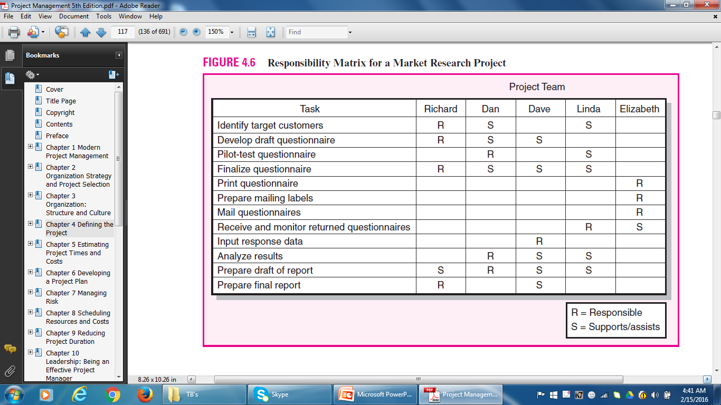

Responsibility Matrix

Slide 32
PROJECT COMMUNICATION PLAN
It is usually created by the PM and/or the Project Team in the early stage of Project Planning.
Communication is key to coordinating and tracking Project Schedules, Issues and Action Items.
It maps out the flow of information to different stakeholders and becomes an integral part of the overall project plan.
The purpose of a PCP is to express what, who, how and when information will be transmitted to project stakeholders so schedules, issues and action items can be tracked.

Slide 33

Project Communication Plan
PCPs address the following core questions:
What Information Needs to be Collected and When?
Who will Receive the Information?
What Methods will be used to Gather and Store Information?
What are the limits, if any, on who has access to certain kinds of information?
When will the information be communicated?
How will it be communicated?

Slide 34

STEPS
Developing a communication plan that answers these questions entails the following basic steps:
1. Stakeholder Analysis: Identify the target groups. Typical groups could be customer, sponsor, project team, project office.
2. Information Needs: Project Progress, Schedules, Task Lists, Specifications, Project Status Reports, Changes In Scope, Action Items, Deliverable Issues, Team Status Meetings, Accepted Request Changes, Milestone Reports.

Slide 35
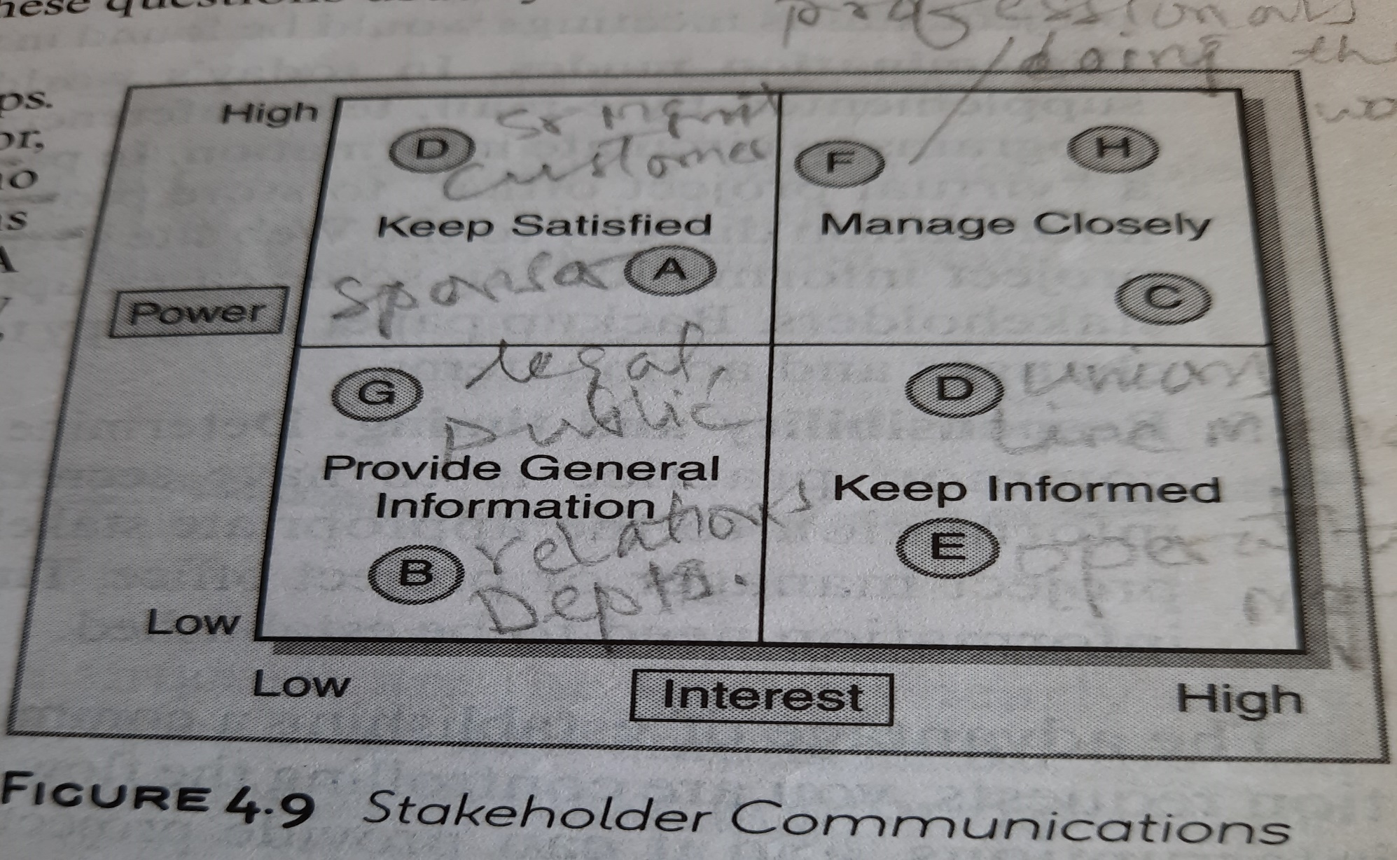
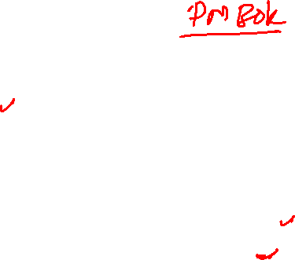

Stakeholder Analysis

Slide 36

Project Communication Plan
3. Sources Of Information: Where does the Information reside? How will it be collected?
4. Dissemination Modes: E-mail, Teleconferencing, etc. Create Virtual Project Office to store Project Information.
5. Responsibility and Timing: Determine who will send out the Information. Timing and frequency of distribution appropriate to the information need to be established.

Slide 37
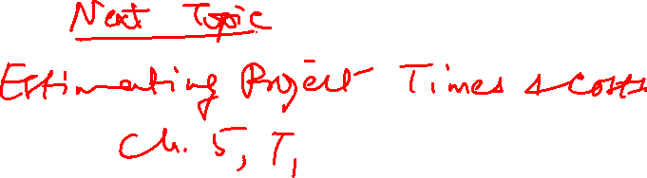


Slide 38
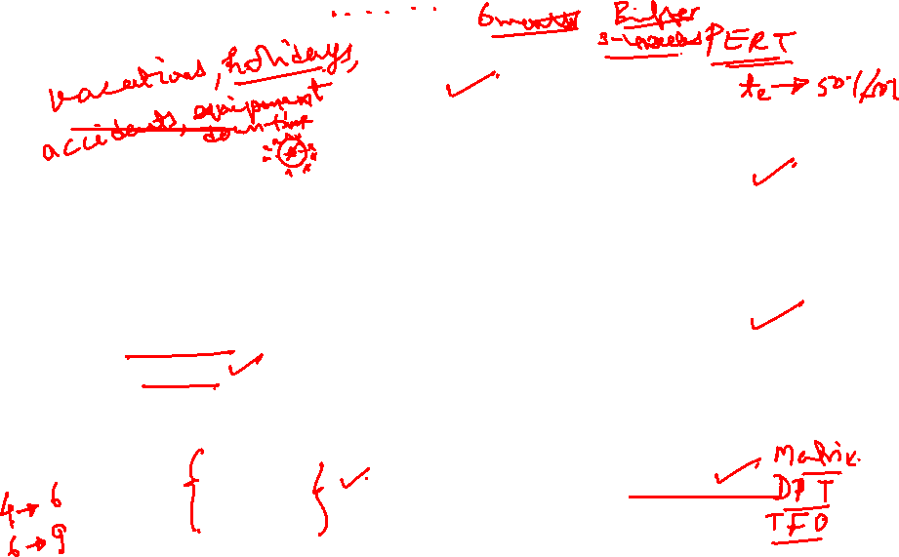
Factors influencing the Quality of Estimates
Planning Horizon
Other (Nonproject)
Factors
Project
Duration
Quality of Estimates
Organization
Culture
People
Padding
Estimates
Project Structure and Organization
5–38

Slide 39
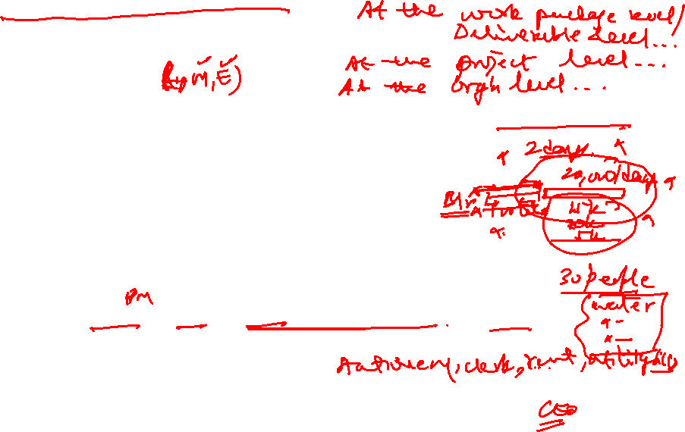
TYPES OF COSTS
Direct Costs
  Costs that are clearly chargeable to a specific work package.
    Labor, materials, equipment, and other
Direct (Project) Overhead Costs
  Costs incurred that are directly tied to an identifiable project deliverable or work package.
    Salary, rents, supplies, specialized machinery
General and Administrative Overhead Costs
  Organization costs indirectly linked to a specific package that are apportioned to the project

Slide 40
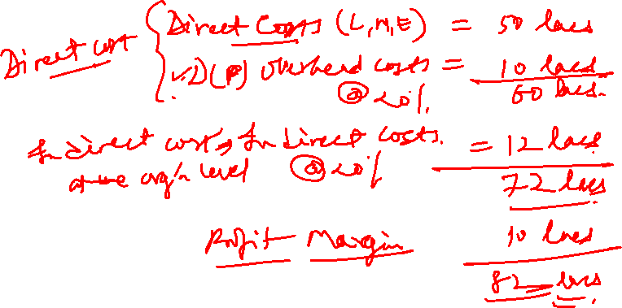

Slide 41
CASE 5.1
Sharp Printing, AG

Slide 42
CASE 5.1
Sharp Printing, AG
At this point, what would you do if you were the project manager?
2. Was top management acting correctly in developing an estimate?
3. What estimating techniques should be used for a mission critical project such as this?

Slide 43
Project Management
Thank You!

